Slide 1
Shiny tutorial – Part III
Alex Fulk
Notes:
Hello everyone, last we started our tutorial on how to use shiny apps and we’ll be continuing that this week.

Slide 2
Content covered so far
Build an app
How to create reactive applications using input and output functions
Sharing your application
What reactivity is
Notes:
So far we have learned
-how to build an application
-how to create reactive applications using input and output functions
-how to share your application using shinyapps.io so that others can utilize it
-what reactivity is and the various ways we can incorporate it into our shiny applications
We also covered how shiny applications are maintained, using an open r session on either a computer or online server and we looked at a template that should be used for every shiny application that you create. Today, we’ll be focusing on the ascetics of applications.
GO TO R AND EXPLAIN HTML CODE GENERATED BY UI FUNCTIONS

Slide 3
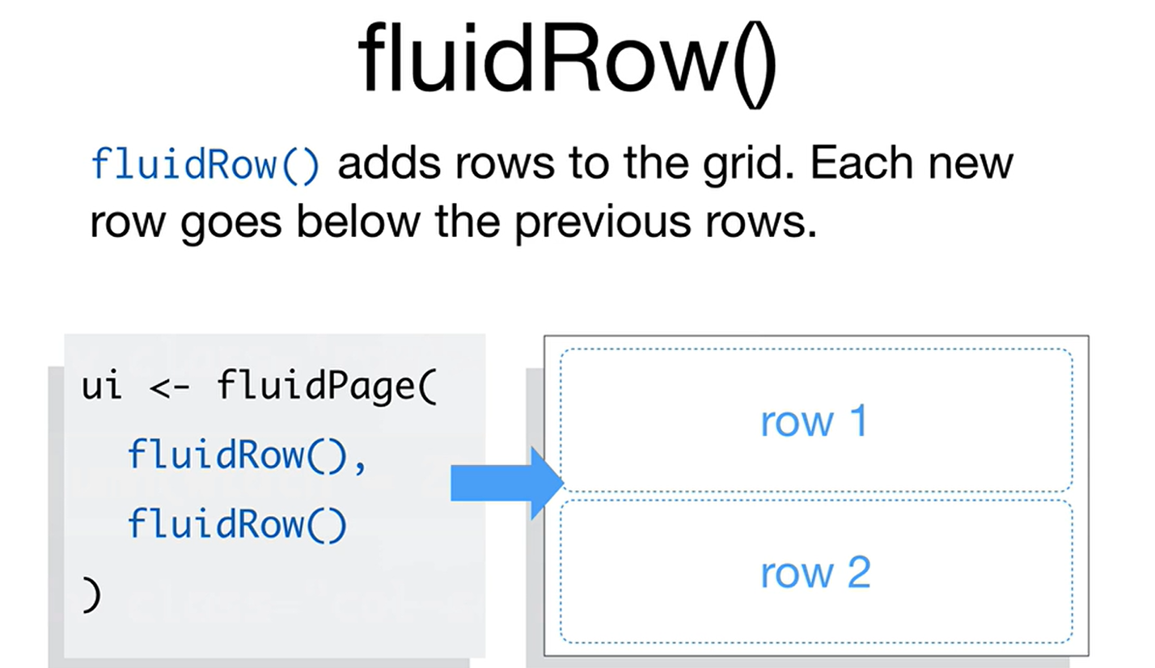

Slide 4
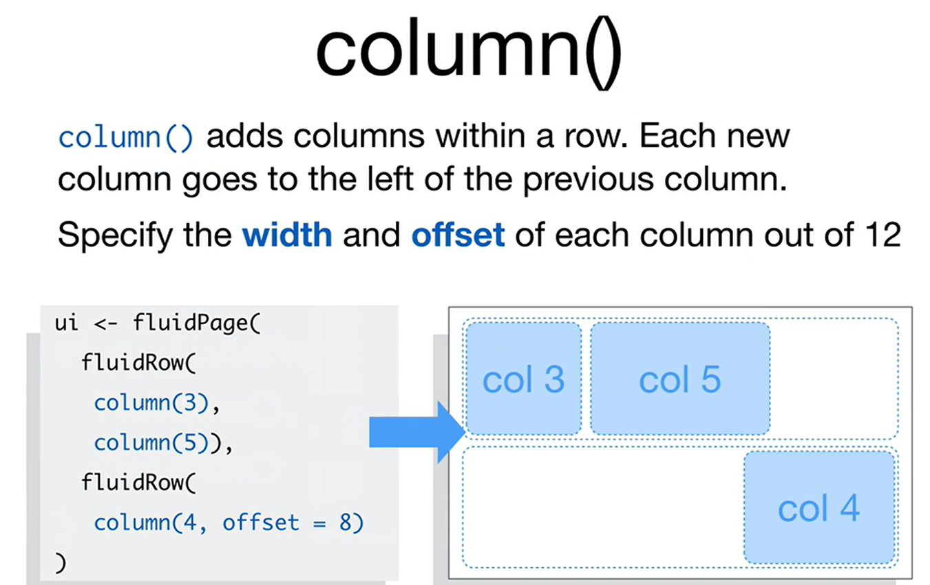

Slide 5
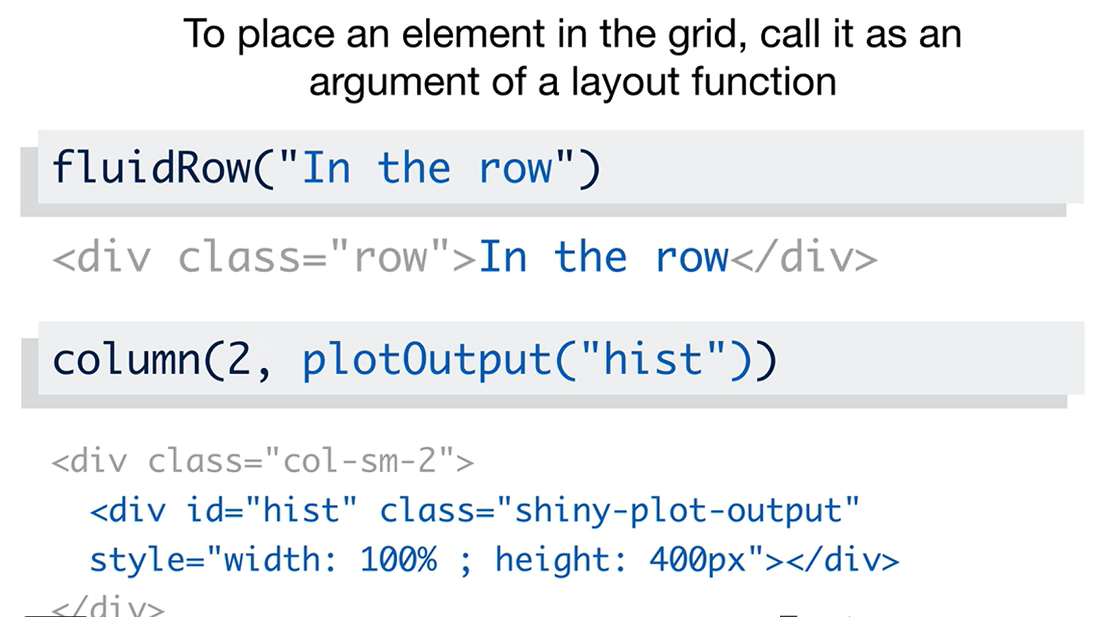

Slide 6
